Slide 1



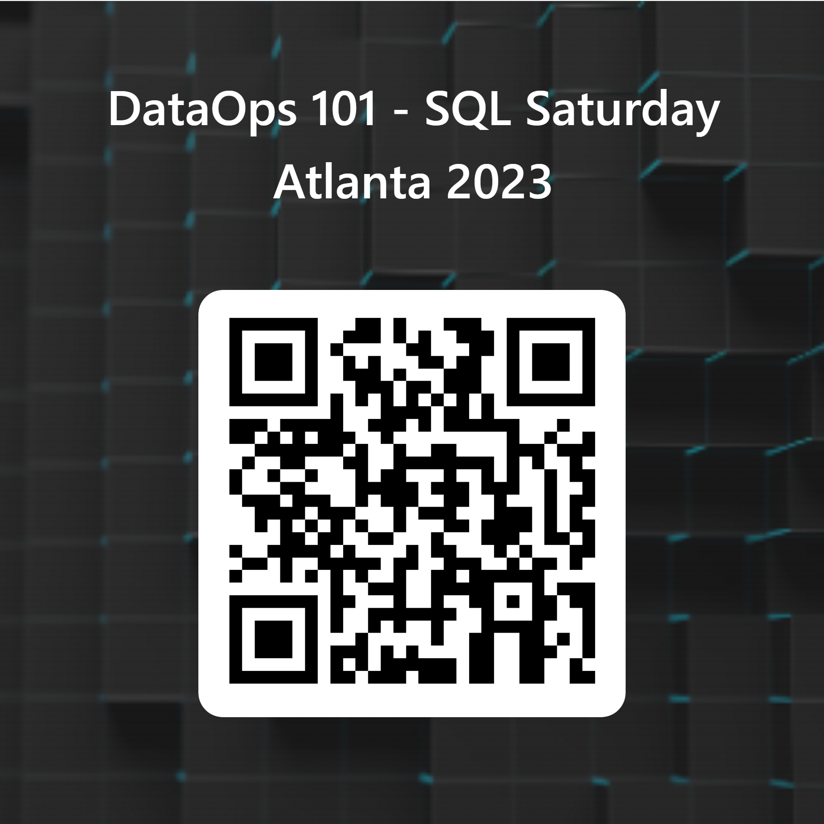
DataOps 101
A Better Way to Develop and Deliver Data Analytics
Take the Poll

Slide 2




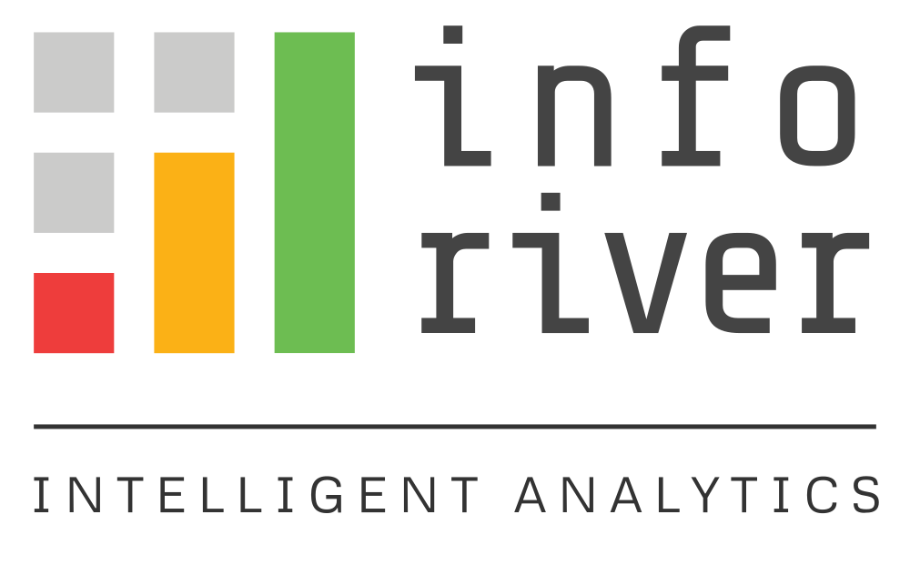



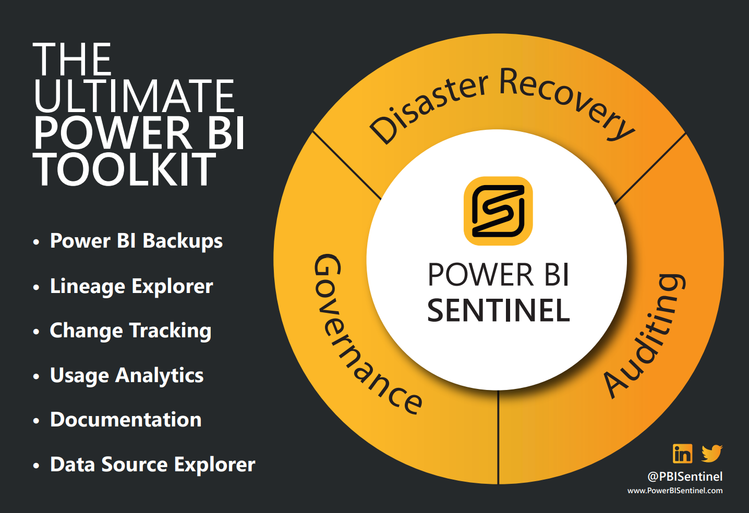
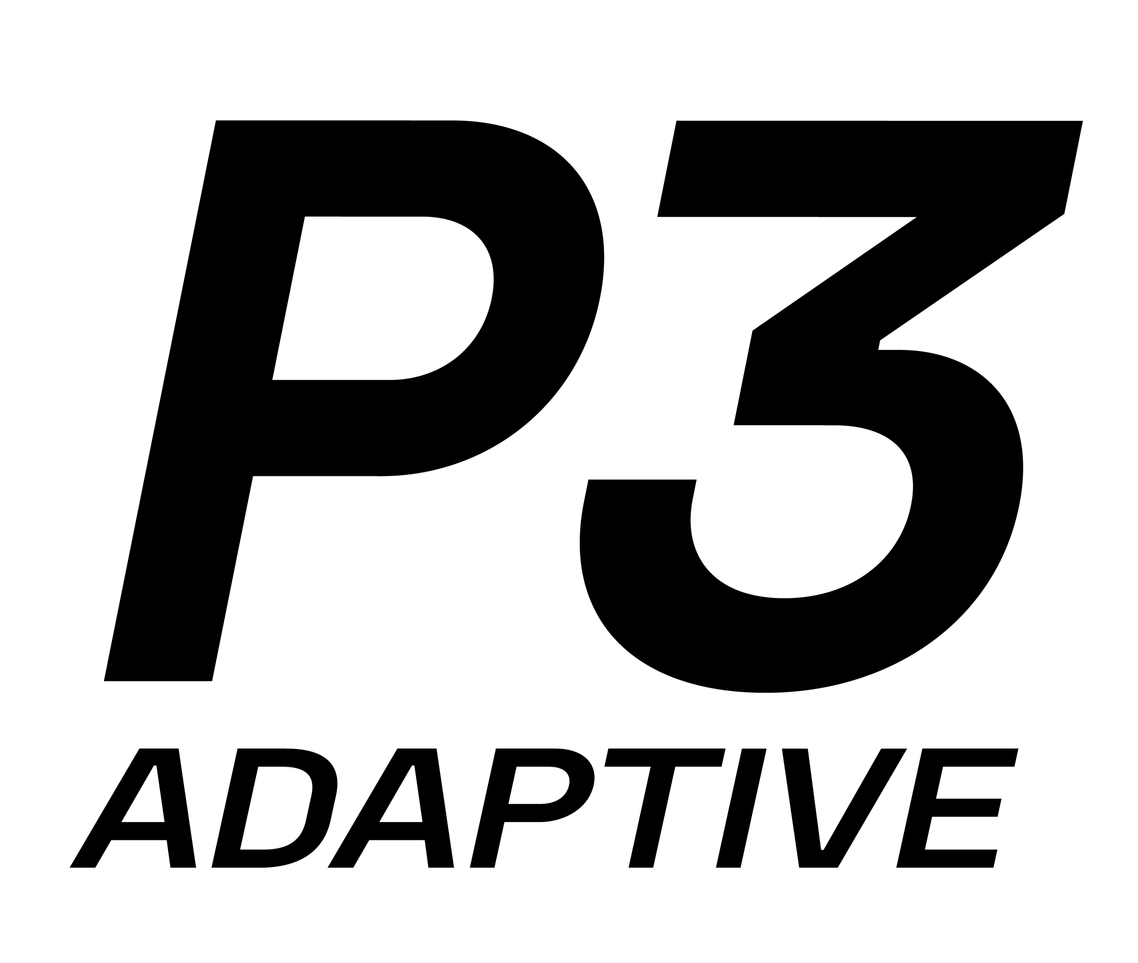

SQL Saturday Atlanta – 2023 Sponsors
Please do not forget to visit our Sponsors table and thank them.

Slide 3





About Me
Experience
Credentials
11+ years with Microsoft BI stack
8+ years with PowerPivot/Power BI
5+ years with Azure DevOps
MCSE: Productivity
MS: PBI Data Analyst
PMP
Contact Me
@JKerski
John Kerski
Blog
Slides:
Notes:
So a little about me, I’ve worked with Power BI since 2015 deploying data analytics solutions to small, medium, and large businesses. And much of what I cover today will be based on my experience with customers and implementing Power BI solutions.
You will also see on this slide that I am project manager, so I’m always looking to improve project delivery, and some of my perspectives in this session will be geared towards the project manager.
My contact information is also provided, as well as my blog articles which are free to read and any code I reference in those articles are free to use under MIT license.
Alright so enough about me, let’s dive in

Slide 4
Agenda
Background
What is DataOps
Why it Matters
How it can Help You
Notes:
In this session, I’ll explain:
The background to what DataOps is trying to solve
I’ll go over the concepts of DataOps and its history
I’ll explain why it matters to the project or projects you’re involved with today
And finally, I’ll cover aspects of DataOps that can help you and your team be more successful.

Slide 5
Background
Poll
https://forms.office.com/r/tLmdbut8VX

Slide 6


Scenario
Alex – The Boss
Bob – The Data Analyst
Notes:
Let me walk you through a scenario because in order to understand DataOps you need to understand the scenario it aims to avoid.
Let’s look at a Teams chat between Alex, the boss, and Bob, the Data Analyst.
Alex – He’s looking to deliver value to the executives. He scoffs when you tell him it will take two weeks to build a report and believes that integrating data from the company's multiple sources will be insight to improving the company's performance.
Now Bob the enterprising and ambitious Data Analyst leading a few team members and has been using Power BI for the better part of six months and based on Alex’s vision, built a Power BI Report for high level executives that combined multi sources of data like SharePoint and SQL. He did it in two weeks and Alex started showing to these executives and want to leverage almost daily.

Slide 7

Day 1
Alex
Great job @Bob, the new Power BI Report is going over well with the executives!
Bob
Thanks! That’s great to hear!

Slide 8

Day 2
Alex IMPORTANT!
@Bob, The executives are in a meeting and the slicer doesn’t have all the options like it did yesterday, can you fix it ASAP?
Bob
I’m on it!
Alex
Thanks for saving the day superhero

Slide 9

Day 3
Alex IMPORTANT!
@Bob, Charlie in Accounting looked at the new Power BI Report and he says the numbers in the table visual don’t add up correctly when you update that slicer you fixed yesterday?
Bob
I’m on it… may take two days because I need to test.
Alex
Let’s get that fixed today.

Slide 10

Day 4
Alex IMPORTANT!
I got a call from an executive, the KPI card that uses the same measure in the table you fixed yesterday looks wrong.
Bob
I’m on it ☹
Alex
Let’s not have more errors today.

Slide 11

Day 5
Alex
Accounting called again, the model has a new column in it, did you do that?
Bob
No, let me check.
Alex
Alright… rough week

Slide 12

Show of Hands
Notes:
Show of hands:
Any one seen this firsthand?
Any one seen a colleague go through this?

Slide 13







Risks
Issues
Defects & Errors
Demand is High
Data is a Strategic Asset but…
Slow Delivery
Complex Data Lineage
More Cost
Data Quality Issues
Disappointment
Notes:
From a project management perspective, a risk is something that could happen, and an issue is a risk that has happened as well as its impact.
With that in mind, in this industry it has become common place to view data as a strategic asset to a company’s mission.
However, we have some risks:
Demand is high - There is such a great need to use data to get a competitive advantage or accelerate capabilities. This demand can put a strain on teams to deliver and continue to deliver at a swift pace.
Complex Data Lineage – often the journey of the data crosses multiple teams, with different skills, and even different bosses or objectives. This complexity can lead to the pipelines that feed your Power BI report to be fragile, and often changes upstream may not be properly communicated to downstream consumers like you.
Data Quality Issues - so I have no doubt that if you have built a Power BI report using data sources you didn’t maintain yourself, issues crop up like:
Missing data OR
Invalid data, like dates that shouldn’t be in the future. OR
Free text fields that should have been a drop-down or field that controlled input. OR
Duplicate data when it should be unique. OR
Schema changes. If you rely on an Excel spreadsheet and had someone change the columns… you know what I’m talking about.
As a member of a data analytics project, these risks are an ever-looming cloud on the horizon, and often can lead to issues like….
Defects & Errors. If left unchecked, defects and errors cause mistrust. Which then means you often have to manually check for issues
Which then leads you to deliver slower because you need to manually check for issues. When you spend more time manually babysitting existing Power BI Reports, your team has less time to build new features or new reports. This then can also lead to….
More costs, because time is money. You either need more staff or more time to maintain existing solutions, or you need more staff or more time to build new solutions as the existing staff are already at capacity.
Ultimately all these issues can lead to…
Disappointment… if you don’t provide insights at the Speed of Relevancy then customers can’t trust you. This leads to you being unhappy, the teams burn out, and low morale.

Slide 14
DataOps
Notes:
So the risks and issues are what we all face in the industry.
I remember some 3-month stretches that were really painful for my project team, I drank way too much soda, and was searching for a better way to avoid these risks with the data platforms we were using.
That’s where DataOps came in. Several years ago, a gentleman named Chris Bergh and his co-founder had similar experiences, and so they wrote the DataOps manifesto.
DataOps is focused on the data scientists, engineers, and analysts who build data models and build insightful visualizations. So What is DataOps exactly?

Slide 15
What is DataOps?
DevOps
Agile
Lean
Manifesto
Notes:
DataOps is a set of technical practices, cultural norms, & architecture that guide teams toward increasing the quality of their data analytic solutions while decreasing the time it takes to deliver those solutions.
It consists of three major industry concepts:
DevOps – More specifically, DataOps embraces continuous integration and continuous deployment, and the importance of cooperation between those who develop and those who manage operations.
Agile – DataOps also taps into Agile concepts by emphasizing self-organizing teams, short sprints, and delivering value quickly to customers.
Lean Manufacturing – Thirdly, DataOps stresses lean manufacturing ideas by simplifying and standardizing processes and increasing automation. DataOps inclusion of Lean also promotes treating data and its transformations as a product on a manufacturing line. Like a real-life manufacturing line, DataOps highlights the need to monitor data quality in every step of the data's transformation.
All these concepts are packaged into the DataOps Manifesto, which eloquently defines the areas of emphasis and principles that should guide data analytic projects and teams.
So looking at DataOps, how does it address the risk and issues I mentioned earlier?

Slide 16

Why It Matters
Defects & Errors
Demand is High
DataOps
Principles
Data is a Strategic Asset but…
Slow Delivery
Complex Data Lineage
More Cost
Data Quality Issues
Disappointment
Notes:
If you incorporate DataOps and more specifically its principles, then you can mitigate:
Many of the errors showing up in your solutions
Track how you are improving in delivery
Be able to empirically show how you deliver solutions, which put you in a better situation with leadership
And more proactively address issues which builds trust with customers.
Alright…

Slide 17
How can it help me?
Notes:
At this point you may be saying: “John, this is a lovely high-level speech… but how can I practically use these concepts so it helps my team and I?”
Well, there are 18 principles…. but I have 5 principles that if you incorporate into your work after this session I believe will improve your projects.
Let’s take a look…

Slide 18
Make it Reproducible
Learn Git
Get your work into Version Control
Reproducible results are required and therefore we version everything: data, low-level hardware and software configurations, and the code and configuration specific to each tool in the toolchain.
Notes:
This first principle is Make it reproducible (read)
Reproducible results are required and therefore we version everything: data, low-level hardware and software configurations, and the code and configuration specific to each tool in the toolchain.
So practically, if your team is not using it today, learn the version control tool Git.
Once you and your team learn Git, get your code into a git repository.
Also, there is also an excellent tool known as pbi-tools that make it easier to track changes to Power BI files incorporating Git.
Now I admit that as of early 2023, Power BI doesn’t make it easy to do version control, but I have resources at the end of this presentation help.
The Bottom line is this principle emphasizes version control.

Slide 19
Quality is Paramount
When you Find an Error, Build a Test
Tests are your Safety Net
Analytic pipelines should be built with a foundation capable of automated detection of abnormalities and security issues in code, configuration, and data, and should provide continuous feedback to operators for error avoidance.
Notes:
This second principle is Quality is paramount (read)
Analytic pipelines should be built with a foundation capable of automated detection of abnormalities and security issues in code, configuration, and data, and should provide continuous feedback to operators for error avoidance.
So what does this mean exactly? Well, when you find an error, build a test.
If you don’t already leverage tools like DAX Studio, Tabular Editor, or Selenium, please write and build tests for both your Power BI data model and Power BI report.
The goal is to never be surprised by the same error again in production.
This principle also means that tests serve as a Safety Net. When you build a suite of tests, you have the ability to give new team members the safety net. Just think if you’re new to a project, and you were asked to update a dataset or a stored procedure, and had some way to make sure it didn’t introduce an issue that happened before? Wouldn’t you feel better?
Now testing is easier said then done in Power BI, but in the resources section I provide you some techniques to get started.

Slide 20
Orchestrate
The beginning-to-end orchestration of data, tools, code, environments, and the analytic teams work is a key driver of analytic success.
Sandbox Management
Develop
Orchestrate (Data)
Test
Deploy
Orchestrate
(Analytics)
Monitor
Continuous Integration
Continuous Deployment
Scripts over Clicks
CI
CD
Notes:
This third principle is Orchestrate (read)
The beginning-to-end orchestration of data, tools, code, environments, and the analytic teams work is a key driver of analytic success.
So to me, orchestration means your project should have
Continuous Integration – If you have version control then you can integrate changes automatically and move to testing automatically.
Orchestration also means having Continuous Deployment.
If you have Continuous Integration, you can automatically deploy solutions to production (like a production Power BI workspace). Then all of a sudden you are delivering quicker.
Orchestration also means emphasizing “Scripts over Clicks”
If you’re using the Azure Portal, Power BI Service, Report Server… you can script the creation of updates. You may need to learn Azure CLI or PowerShell or Power Automate (low-code), but manually clicking a setup of an environment or changes introduces a chance for error. Clicks require you to take screenshots and build documentation. And in our cloud-based world, interfaces change. I still find old sky-blue Azure Portal screenshots on Microsoft documentation, but the Azure CLI commands stay pretty consistent, so save yourself having to retake screenshots and build scripts instead.
Now, this is a good time to point out Orchestration happens twice. On the slide I’ve tried to illustrate that.
The first orchestration happens when you build the data pipelines and bring the value in the form of models, data warehouse, and delta lakes. This could be done in Azure Data Factory, Power Query, or some other tool.
The second orchestration happens in form of data analytics. This is when you build the visuals and/or dashboards consumed by your customers.
To reiterate let’s give you another example. The first orchestrate could be the testing and deployment of Azure Synapse pipelines that builds a set of dimensions and fact tables.
Now that you have the data, the second part of orchestrate is that you need to isolate some parts of that data to build the complicated DAX that calculates financial metrics for a Power BI Dashboard. You’re not testing the data now, but rather the DAX code to make sure it’s calculating as expected. You’re also testing to make sure the Power BI slicers or filters are behaving as expected and testing to make sure your Power BI product meets accessibility standards.
Orchestration leads to huge time savings by eliminating manual steps, so you and your team can focus on building impactful data models and visuals.
Alright, I’ve discussed 3 principles, we’ve got two more to go…

Slide 21
Monitor quality and performance
Our goal is to have performance, security and quality measures that are monitored continuously to detect unexpected variation and generate operational statistics.
Catch the Errors Before Your Customers Do
Practice What You Build
Notes:
This fourth principle is Monitor quality and performance (read)
Our goal is to have performance, security and quality measures that are monitored continuously to detect unexpected variation and generate operational statistics.
From the lean manufacturing world this is known as statistical process control. If a column of data used in a report was 10% empty but jumps to 15% over night, you’d want to know right?
So in my own terms, this principle means:
Catch the Errors Before Your Customers Do. The most impactful moments I have had with client leadership is when I came to them telling them our monitoring identified that a problem occurred, we are fixing it, and we’ve notified the impacted community. This builds trust.
This also means as a project team you need to practice what you build
We provide services with data and often around performance management. Customers use this information to track their quality and performance. Your team should be no different in that way.

Slide 22
Reduce Heroism
As the pace and breadth of need for analytic insights ever increases, we believe analytic teams should strive to reduce heroism and create sustainable and scalable data analytic teams and processes.
Avoid Burnout
Notes:
This fifth and final principle is Reduce Heroism (read)
As the pace and breadth of need for analytic insights ever increases, we believe analytic teams should strive to reduce heroism and create sustainable and scalable data analytic teams and processes.
Reduce Heroism, to me, means Avoid Burnout
Many of you watching this have had burn-out. I know I have and I have team members who have.
Burnout is when you have Exhaustion, feeling drained or emotionally exhausted and don’t have enough energy to tackle tasks.
Burnout leads to alienation from work-related activities. People with burnout may start being cynical about their working conditions and their colleagues. At the same time, they may increasingly distance themselves emotionally, and start feeling numb about their work.
Burnout also reduces performance. It affects everyday tasks at work, at home or when caring for family members. People with burnout are very negative about their tasks, and find it hard to concentrate.
DataOps emphasizes that you don’t want you or your team to constantly swoop in to fix issues manually.
As a hero, you become overwhelmed, you won’t be able to work on cool new things, and you put your coworkers and clients in a bad position if they can’t easily support the solutions.
Ultimately, it leads to either you being frustrated and looking for a new job and/or your coworkers looking to move on.
Alright, let’s recap

Slide 23
Recap – How Can it Help You
Make It Reproducible - Learn/Embrace Git
Quality is Paramount - Find an Error, Build a Test
Orchestration - Implement CI/CD
Monitor Quality and Performance - Catch Errors Before Your Clients Do
Reduce Heroism – Avoid Burnout
Notes:
By following these 5 principles, you can start building better solutions.
When you apply the principle of Make It Reproducible, you learn to use version control with Git.
By applying Quality is Paramount – you are building tests to avoid errors you’ve encountered.
Using Orchestration – you implemented Continuous Integration and Continuous Deployment to reduce manual steps and reduce time to deliver solutions.
With monitor quality and performance, you are proactively addressing issues and notifying clients so that you can build more trust.
And last, but not certainly not least, by reducing heroism your team avoids burnout and maybe you can take a vacation for once.

Slide 24
DataOps Aphorisms
It is not about the fear of making a change; it is about the removal of fear from making changes.
It is not about data quality; it is about low rates of error.
It is not about the next analysis; it is about building a system that makes it easier to answer the next analysis.
You spend all day helping your customers be more analytic, so why are you so un-analytic about how you run your data analytics teams?
Don’t solve problems, figure out how to never create them in the first place.
Notes:
If you don’t like my sayings; then try these aphorism from DataOps.
An observation that contains a general truth that I love.
1st – Fear – Git and Testing lets you do this.
2nd – Data Quality – Upstream data has issues, highlight them, make sure you’re not introduce new issues.
3rd – Orchestrate
4th – Catch Errors Before Your Clients Do
5th - Heroism

Slide 25
Resources
General
DataOps Cookbook
DataOps – Chris Bergh
Version Control
GitHub Desktop Tutorial
pbi-tools
Testing & Orchestration
Video
Visual Testing
Monitoring
Template
Notes:
In General please read the DataOps Cookbook and watch Chris Bergh’s video on DataOps. You’ve listened to me talk about DataOps why not also read and watch about DataOps from the founders perspective.
For Version Control I’ve provided a tutorial for using GitHub Desktop, a wonderful tool for getting started with Git.
I also have a link here to pbi-tools. This is a great tool that will help provide version control for Power BI products, and I recommend going to this site and watching the video tutorials.
For Testing and Orchestration I have another video that walks through a free template to get started. I also provide instructions on how to do some visual testing with Power BI with the help of pbi-tools.
And for Monitoring, I offer instructions to use a free template that will help you monitor your Power BI workspaces for common issues.

Slide 26
Questions?
Slides:

